Slide 1
Introduction to C# in Visual Studio
Only Topics discussed in the workshops are included for more topics check the links section (last slide)
World One Powerful Presentation Template
Notes:
Roboto Condensed font

Slide 2
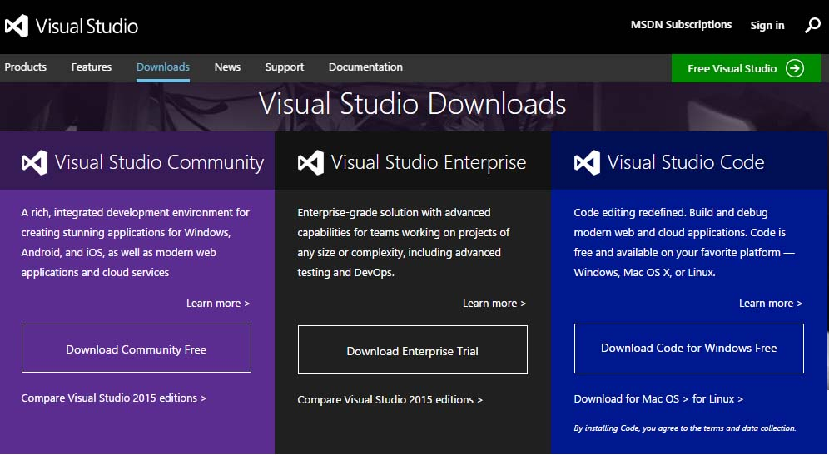
Download Visual Studio 2015 Community
http://www.visualstudio.com/en-us/downloads/visual-studio-2015-downloads-vs.aspx

Slide 3
Part 1
Environment
Program Structure
Basic Syntax
Data types
Variables
Operators

Slide 4
Environment

Slide 5
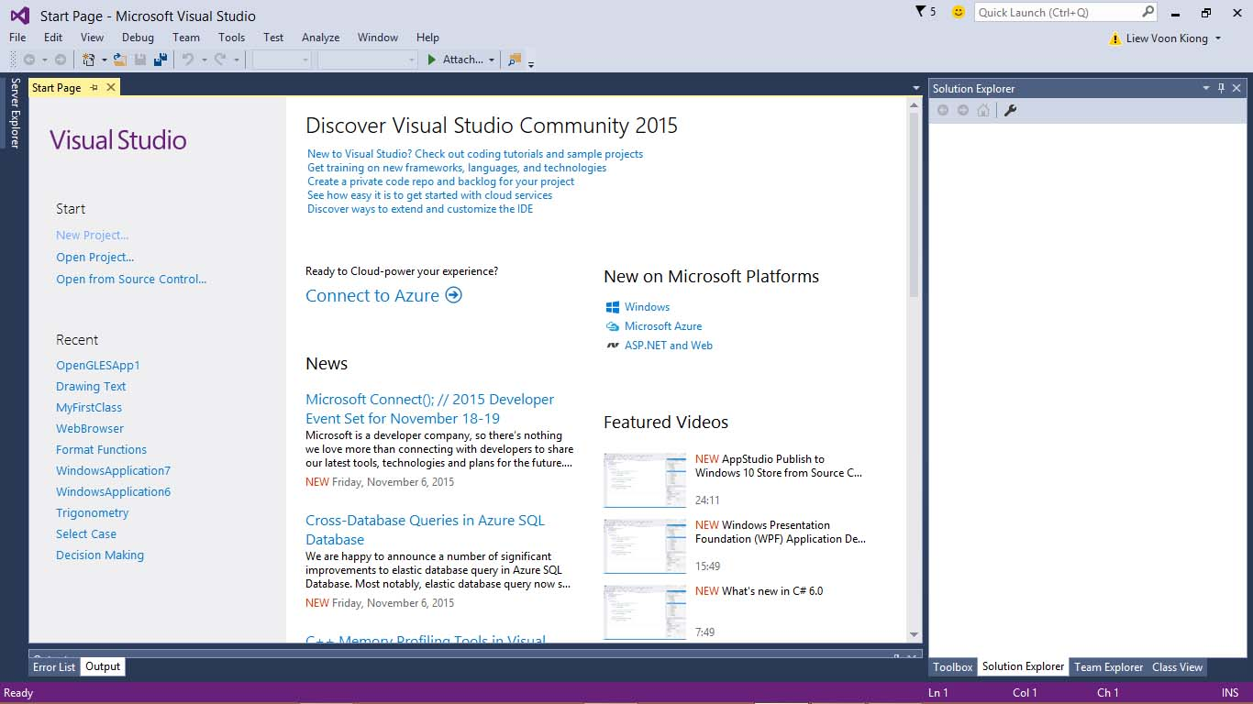
Visual Studio 2015
Integrated Development Environment (IDE) for C#

Slide 6
Integrated Development Environment (IDE) for C#
It is a software application that provides comprehensive facilities to computer programmers for software development. An IDE normally consists of a source code editor, build automation tools and a debugger.

Slide 7
How to create a new project?

Slide 8
choose New Project
or go to File -> New -> Project

Slide 9
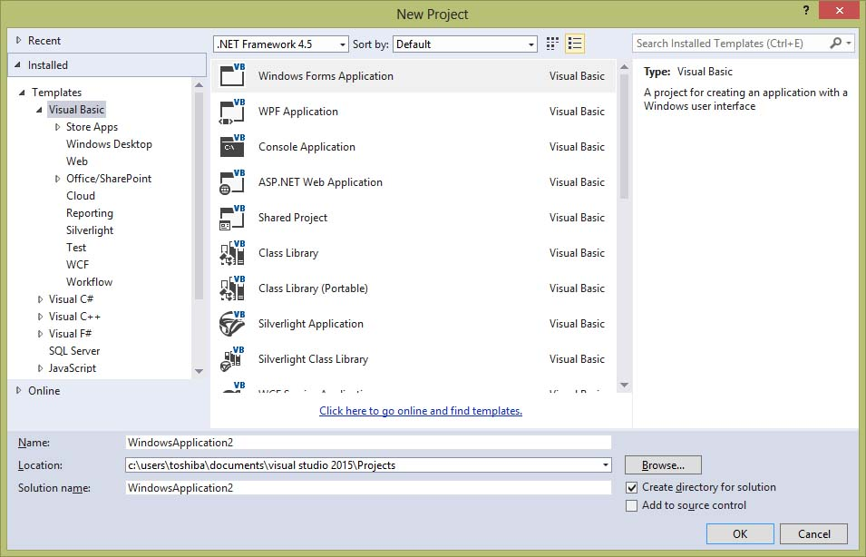
The .Net framework consists of an enormous library of codes used by the client languages such as C#
project templates are divided into categories based on the language used and the type of the project
ex. Console Application
name the project
choose the project location (you can keep it as it is)
Choose the project template you want
ex. C# -> Console Application

Slide 10
Basic Concepts
01
02
03
04
- Classes
- Attributes
- Methods
- Objects
- Variables
- Initializing variables
- Data type
- Operators (Logical and Arithmetic)
- Comparison
- String concatenation
- Increment and decrement
- Flow control
- If statements
- Loops
- Comments (single and multiline)
Basic Structure
Variables
Operators
Flow of Control

Slide 11
Program Structure

Slide 12
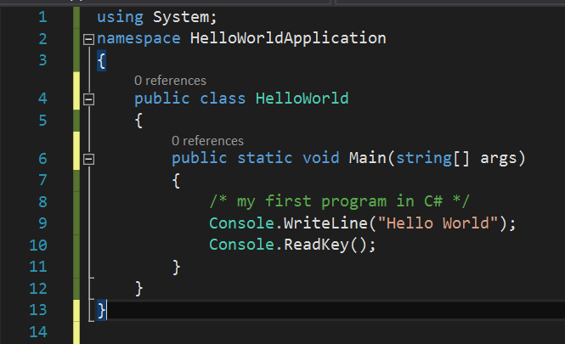
using keyword - used to include the System namespace in the program. A program generally has multiple using statements.
Namespace declaration - a collection of classes
A Class - contains the data and method definitions that your program uses. Classes generally contain multiple methods.
**Methods - define the behavior of the class.
A Main method - the entry point for all C# programs. The Main method states what the class does when executed.
Comments - The line /*...*/ is ignored by the compiler and it is put to add comments in the program.
Statements and Expressions - WriteLine is a method of the Console class defined in the System namespace. This statement causes the message "Hello, World!" to be displayed on the screen.
Sample Console Application Code
Program Structure and elements

Slide 13
Basic Syntax

Slide 14
C# Keywords
Reserved Keywords
abstract | as | base | bool | break | byte | case
catch | char | checked | class | const | continue | decimal
default | delegate | do | double | else | enum | event
explicit | extern | FALSE | finally | fixed | float | for
foreach | goto | if | implicit | in | in | int
interface | internal | is | lock | long | namespace | new
null | object | operator | out | out | override | params
private | protected | public | readonly | ref | return | sbyte
sealed | short | sizeof | stackalloc | static | string | struct
switch | this | throw | TRUE | try | typeof | uint
ulong | unchecked | unsafe | ushort | using | virtual | void
volatile | while
Keywords can’t be used as classes’, variables’ or methods’ names as they hold special meaning for the program

Slide 15
Data Types

Slide 16
Value Types
Value type variables can be assigned a value directly. They are derived from the class System.ValueType. They directly contain data, When you declare an int type, the system allocates memory to store the value.
Type | Represents | Range | Default Value
bool | Boolean value | True or False | FALSE
byte | 8-bit unsigned integer | 0 to 255 | 0
char | 16-bit Unicode character | U +0000 to U +ffff | \0'
decimal | 128-bit precise decimal values with 28-29 significant digits | (-7.9 x 10²⁸ to 7.9 x 10²⁸) / 10^{0 to 28} | 0.0M
double | 64-bit double-precision floating point type | (+/-)5.0 x 10⁻³²⁴ to (+/-)1.7 x 10³⁰⁸ | 0.0D
float | 32-bit single-precision floating point type | -3.4 x 10³⁸ to + 3.4 x 10³⁸ | 0.0F
int | 32-bit signed integer type | -2,147,483,648 to 2,147,483,647 | 0

Slide 17
Reference Types
The reference types do not contain the actual data stored in a variable, but they contain a reference to the variables. In other words, they refer to a memory location. Example of built-in reference types are: object, dynamic, and string.
Object Type
Dynamic Type
String Type

Slide 18
Object Type
the ultimate base class for all data types in C# Common Type System (CTS). Object is an alias for System.Object class. The object types can be assigned values of any other types, value types, reference types, predefined or user-defined types. However, before assigning values, it needs type conversion.
When a value type is converted to object type, it is called boxing and on the other hand, when an object type is converted to a value type, it is called unboxing.
Ex.
object obj;
obj = 100; // this is boxing
another style for commenting

Slide 19
Dynamic Type
You can store any type of value in the dynamic data type variable. Type checking for these types of variables takes place at run-time.
Dynamic types are similar to object types except that type checking for object type variables takes place at compile time, whereas that for the dynamic type variables takes place at run time.
Syntax
dynamic <variable_name> = value;
Ex.
dynamic d = 20;

Slide 20
String Type
The String Type allows you to assign any string values to a variable. The string type is an alias for the System.String class. It is derived from object type.
Ex.
String str = "Tutorials Point";

Slide 21
Variable
A variable is nothing but a name given to a storage area that our programs can manipulate. Each variable in C# has a specific type, which determines the size and layout of the variable's memory the range of values that can be stored within that memory and the set of operations that can be applied to the variable.

Slide 22
Variables

Slide 23
Defining a Variable
Syntax
<data_type> <variable_list>;
Ex.
int i, j, k;
char c, ch;
float f, salary;
double d;
Initialize a variable after initializing it or at the time of definition as:
Ex.
c = ‘a’;
int i = 100;
int d = 3, f = 5; /* initializing d and f.*/

Slide 24
Accepting Values from User
The Console class in the System namespace provides a function ReadLine() for accepting input from the user and store it into a variable.
Ex.
int num;
num = Convert.ToInt32(Console.ReadLine());
The function Convert.ToInt32() converts the data entered by the user to int data type, because Console.ReadLine() accepts the data in string format.

Slide 25
Operators

Slide 26
Arithmetic operators
Following table shows all the arithmetic operators supported by C#. Assume variable A holds 10 and variable B holds 20 then:
Operator | Description | Example
+ | Adds two operands | A + B = 30
- | Subtracts second operand from the first | A - B = -10
* | Multiplies both operands | A * B = 200
/ | Divides numerator by de-numerator | B / A = 2
% | Modulus Operator and remainder of after an integer division | B % A = 0
++ | Increment operator increases integer value by one | A++ = 11
-- | Decrement operator decreases integer value by one | A-- = 9

Slide 27
Relational operators
Following table shows all the relational operators supported by C#. Assume variable A holds 10 and variable B holds 20 then:
Operator | Description | Example
== | Checks if the values of two operands are equal or not, if yes then condition becomes true. | (A == B) is not true.
!= | Checks if the values of two operands are equal or not, if values are not equal then condition becomes true. | (A != B) is true.
> | Checks if the value of left operand is greater than the value of right operand, if yes then condition becomes true. | (A > B) is not true.
< | Checks if the value of left operand is less than the value of right operand, if yes then condition becomes true. | (A < B) is true.
>= | Checks if the value of left operand is greater than or equal to the value of right operand, if yes then condition becomes true. | (A >= B) is not true.
<= | Checks if the value of left operand is less than or equal to the value of right operand, if yes then condition becomes true. | (A <= B) is true.

Slide 28
Logical operators
Following table shows all the logical operators supported by C#. Assume variable A holds 10 and variable B holds 20 then:
Operator | Description | Example
&& | Called Logical AND operator. If both the operands are non zero then condition becomes true. | (A && B) is false.
|| | Called Logical OR Operator. If any of the two operands is non zero then condition becomes true. | (A || B) is true.
! | Called Logical NOT Operator. Use to reverses the logical state of its operand. If a condition is true then Logical NOT operator will make false. | !(A && B) is true.

Slide 29
Assignment operators
Following table shows all the assignment operators supported by C#. Assume variable A holds 10 and variable B holds 20 then:
Operator | Description | Example
= | Simple assignment operator, Assigns values from right side operands to left side operand | C = A + B assigns value of A + B into C
+= | Add AND assignment operator, It adds right operand to the left operand and assign the result to left operand | C += A is equivalent to C = C + A
-= | Subtract AND assignment operator, It subtracts right operand from the left operand and assign the result to left operand | C -= A is equivalent to C = C - A
*= | Multiply AND assignment operator, It multiplies right operand with the left operand and assign the result to left operand | C *= A is equivalent to C = C * A
/= | Divide AND assignment operator, It divides left operand with the right operand and assign the result to left operand | C /= A is equivalent to C = C / A

Slide 30
Part 2
Decision Making
Loops
Encapsulation
Methods

Slide 31
Decision Making

Slide 32
Decision making structures requires the programmer to specify one or more conditions to be evaluated or tested by the program, along with a statement or statements to be executed if the condition is determined to be true, and optionally, other statements to be executed if the condition is determined to be false.

Slide 33
if statement
Syntax
if(boolean_expression)
{
/* statement(s) will execute if the boolean expression is true */
}
Ex.
/* local variable definition */
int a = 10;
/* check the boolean condition using if statement */
if (a < 20)
{
/* if condition is true then print the following */
Console.WriteLine("a is less than 20");
}

Slide 34
if-else statement
Syntax
if(boolean_expression)
{
/* statement(s) will execute if the boolean expression is true */
}
else
{
/* statement(s) will execute if the boolean expression is false */
}

Slide 35
if-else if-else statement
Ex.
Syntax
/* local variable definition */
int a = 100;
/* check the boolean condition */
if (a == 10) {
/* if condition is true then print the following */
Console.WriteLine("Value of a is 10");
} else if (a == 20) {
/* if else if condition is true */
Console.WriteLine("Value of a is 20");
} else {
/* if none of the conditions is true */
Console.WriteLine("None of the values is matching");
}
if(boolean_expression 1)
{
/* Executes when the boolean expression 1 is true */
}
else if( boolean_expression 2)
{
/* Executes when the boolean expression 2 is true */
}
else if( boolean_expression 3)
{
/* Executes when the boolean expression 3 is true */
}
else
{
/* executes when the none of the above condition is true */
}

Slide 36
Nested if statement
Ex.
Syntax
//* local variable definition */
int a = 100;
int b = 200;
/* check the boolean condition */
if (a == 100){
/* if condition is true then check the following */
if (b == 200){
/* if condition is true then print the following */
Console.WriteLine("Value of a is 100 and b is 200");
}
}
if( boolean_expression 1)
{
/* Executes when the boolean expression 1 is true */
if(boolean_expression 2)
{
/* Executes when the boolean expression 2 is true */
}
}

Slide 37
Loops

Slide 38
A loop statement allows us to execute a statement or a group of statements multiple times and following is the general from of a loop statement in most of the programming languages:

Slide 39
for loop
Syntax
for ( init; condition; increment )
{
statement(s);
}
Ex.
/* for loop execution */
for (int a = 10; a < 20; a = a + 1){
Console.WriteLine("value of a: {0}", a);
}

Slide 40
while loop
Syntax
while(condition)
{
statement(s);
}
Ex.
/* local variable definition */
int a = 10;
/* while loop execution */
while (a < 20){
Console.WriteLine("value of a: {0}", a);
a++;
}

Slide 41
do - while loop
Syntax
do
{
statement(s);
}while( condition );
Ex.
/* local variable definition */
int a = 10;
/* do loop execution */
do {
Console.WriteLine("value of a: {0}", a);
a = a + 1;
} while (a < 20);

Slide 42
Nested loops
Ex.
Syntax
/* local variable definition */
int i, j;
for (i = 2; i < 100; i++) {
for (j = 2; j <= (i / j); j++)
if ((i % j) == 0) break; // if factor found, not prime
if (j > (i / j))
Console.WriteLine("{0} is prime", i);
}
for ( init; condition; increment )
{
for ( init; condition; increment )
{
statement(s);
}
statement(s);
}

Slide 43
Loop Control Statements
Loop control statements change execution from its normal sequence. When execution leaves a scope, all automatic objects that were created in that scope are destroyed.
Control Statement | Description
break statement | Terminates the loop or switch statement and transfers execution to the statement immediately following the loop or switch.
continue statement | Causes the loop to skip the remainder of its body and immediately retest its condition prior to reiterating.

Slide 44
Infinite loop
A loop becomes infinite loop if a condition never becomes false. The for loop is traditionally used for this purpose. Since none of the three expressions that form the for loop are required, you can make an endless loop by leaving the conditional expression empty.
Ex.
for (; ; ){
Console.WriteLine("Hey! I am Trapped");
}

Slide 45
Encapsulation

Slide 46
Encapsulation is defined 'as the process of enclosing one or more items within a physical or logical package'. Encapsulation, in object oriented programming methodology, prevents access to implementation details.
Abstraction and encapsulation are related features in object oriented programming. Abstraction allows making relevant information visible and encapsulation enables a programmer to implement the desired level of abstraction.

Slide 47
Access Specifiers
Public
Private
Protected
Internal
Protected internal

Slide 48
Public Access Specifier
Public access specifier allows a class to expose its member variables and member functions to other functions and objects. Any public member can be accessed from outside the class.

Slide 49
Private Access Specifier
Private access specifier allows a class to hide its member variables and member functions from other functions and objects. Only functions of the same class can access its private members. Even an instance of a class cannot access its private members.

Slide 50
Protected Access Specifier
Protected access specifier allows a child class to access the member variables and member functions of its base class. This way it helps in implementing inheritance.

Slide 51
Internal Access Specifier
Internal access specifier allows a class to expose its member variables and member functions to other functions and objects in the current assembly. In other words, any member with internal access specifier can be accessed from any class or method defined within the application in which the member is defined.

Slide 52
Protected Internal Access Specifier
The protected internal access specifier allows a class to hide its member variables and member functions from other class objects and functions, except a child class within the same application. This is also used while implementing inheritance.

Slide 53
Methods

Slide 54
A method is a group of statements that together perform a task. Every C# program has at least one class with a method named Main.
To use a method, you need to:
Define the method
Call the method

Slide 55
Defining a Method
Syntax
<Access Specifier> <Return Type> <Method Name>(Parameter List)
{
Method Body
}
Access Specifier: This determines the visibility of a variable or a method from another class.
Return type: A method may return a value. The return type is the data type of the value the method returns. If the method is not returning any values, then the return type is void.
Method name: Method name is a unique identifier and it is case sensitive. It cannot be same as any other identifier declared in the class.
Parameter list: Enclosed between parentheses, the parameters are used to pass and receive data from a method. The parameter list refers to the type, order, and number of the parameters of a method. Parameters are optional; that is, a method may contain no parameters.
Method body: This contains the set of instructions needed to complete the required activity.

Slide 56
Calling a Method
Ex.
using System;
namespace CalculatorApplication
{
class NumberManipulator {
public int FindMax(int num1, int num2){
/* local variable declaration */
int result;
if (num1 > num2)
result = num1;
else
result = num2;
return result;
}
}
..
..
class Test {
static void Main(string[] args){
/* local variable definition */
int a = 100;
int b = 200;
int ret;
NumberManipulator n = new NumberManipulator();
//calling the FindMax method
ret = n.FindMax(a, b);
Console.WriteLine("Max value is : {0}", ret );
Console.ReadLine();
}
}
}

Slide 57
Useful Links
C# Fundamentals for absolute beginners - video
https://mva.microsoft.com/en-US/training-courses/c-fundamentals-for-absolute-beginners-16169?l=Lvld4EQIC_2706218949
C# tutorial - online documentations
http://www.tutorialspoint.com/csharp/index.htm
Programming in C# Jump Start
https://mva.microsoft.com/en-US/training-courses/programming-in-c-jump-start-14254

